Slide 1


Chicago Crime rate
How Socioeconomic factors influence the crime rate

Slide 2


Analysts
Christopher Habib
Siddharth Krishnan
Ali Kashani
Elmaddin Karimov

Slide 3

Data Curated datasets:
https://dev.socrata.com/foundry/data.cityofchicago.org/6zsd-86xi
https://data.cityofchicago.org/Health-Human-Services/Census-Data-Selected-socioeconomic-indicators-in-C/kn9c-c2s2

Slide 4
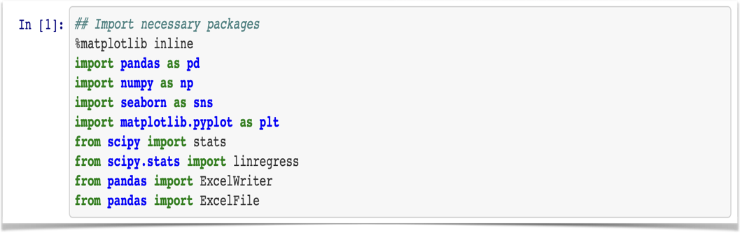
Import Packages
The above Packages for executing our analysis

Slide 5
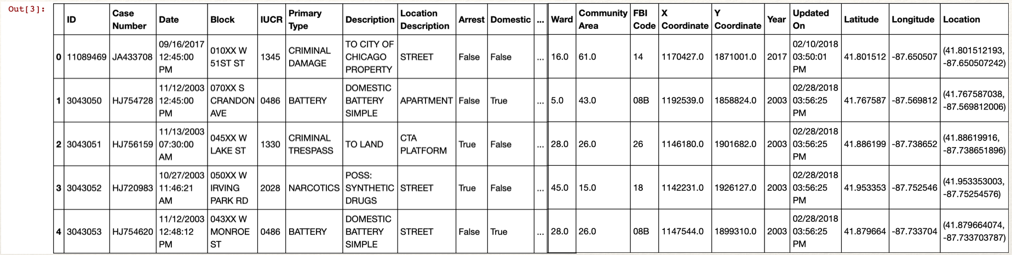
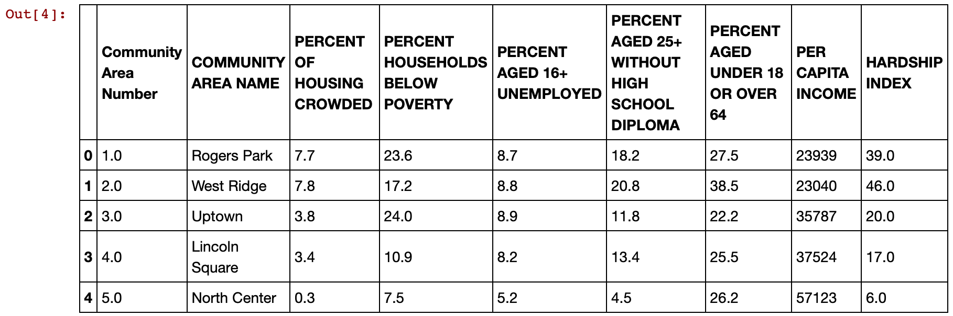
df = pd.read_csv(‘resources/Crimes_-_2001_to_present.csv')
census = pd.read_csv('resources/Census_Data_-_Selected_socioeconomic_indicators_in_Chicago__2008___2012.csv')

Slide 6
Approach
Find crime types and obtain data from the right source
Analyze and clean data
Find the most frequently committed crime
By using the socioeconomic indicators we analyzed 4 years of data
Select crime data for 5 years 2008-2012
Merge the new data to get meaningful insights
Analyse impact of indicators on theft levels
Analyse correlation between theft and crime levels

Slide 7
Data Cleaning
Changed combined thefts, robberies and auto-thefts into a single THEFT category
Merged both datasets on Community Area column
Checked for null-values

Slide 8

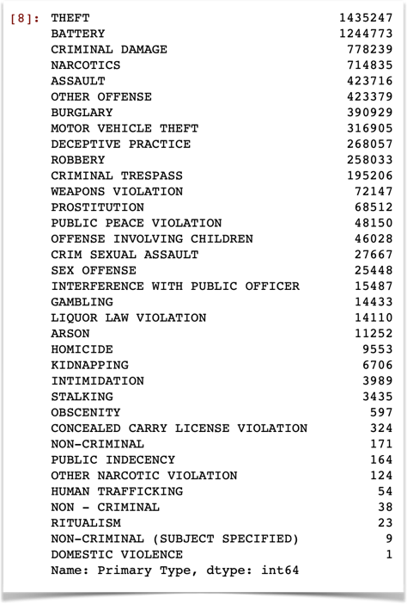
By using this syntax
We determined the most committed Crime
df['Primary Type'].value_counts()

Slide 9
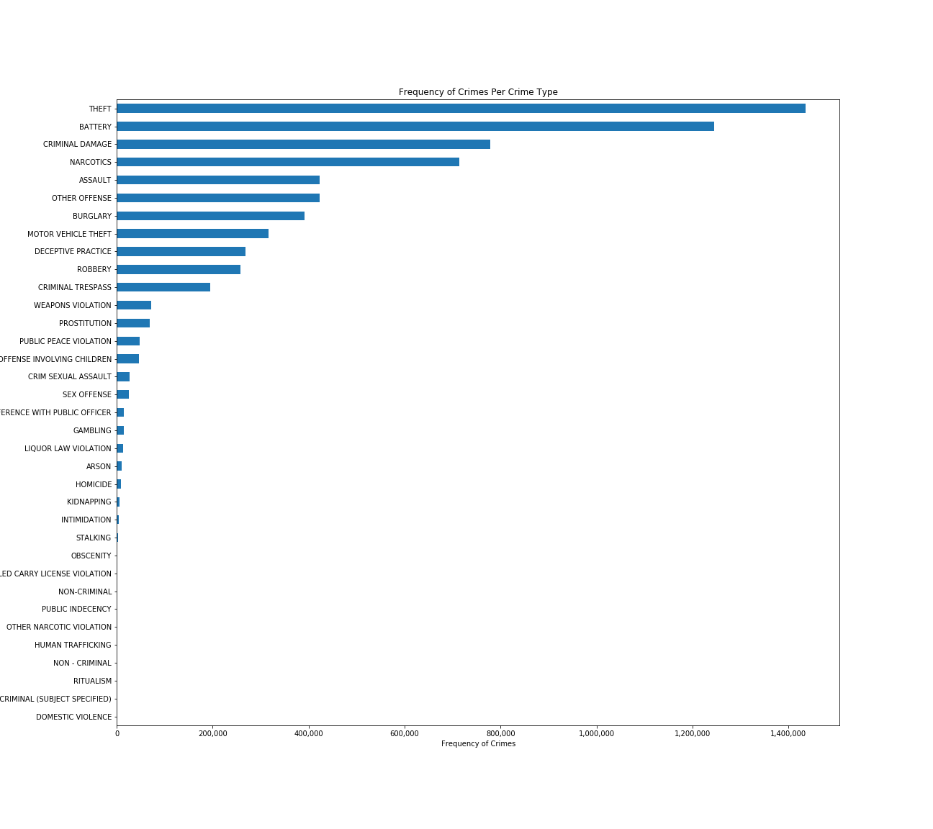

Slide 10
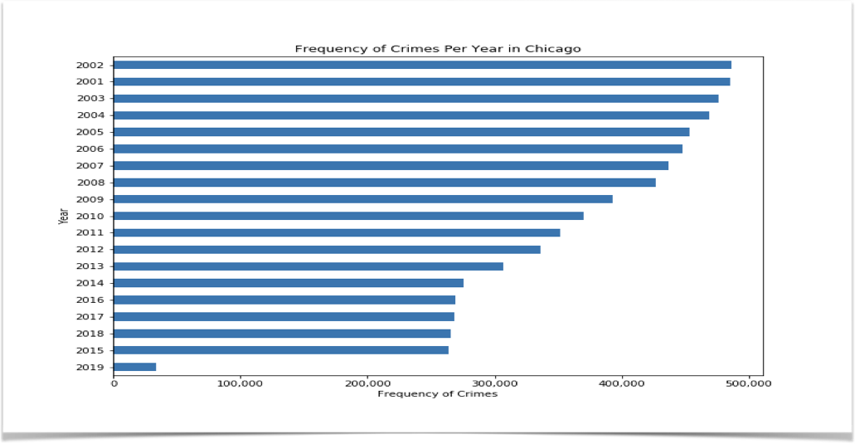
Determined Frequency of Crimes per year

Slide 11
Merging the Data to analyse and determine a relationship
Between Hardship Index and Theft
crime08 = df.loc[df["Year"]==2008]
crime09 = df.loc[df[“Year"]==2009]
crime10 = df.loc[df["Year"]==2010]
crime11 = df.loc[df["Year"]==2011]
crime11 = df.loc[df["Year"]==2011]
crime12 = df.loc[df["Year"]==2012]
crime_data=pd.merge(crime08,census,on="Community Area")
crime_data1=pd.merge(crime09,census,on="Community Area")
crime_data2=pd.merge(crime10,census,on="Community Area")
crime_data3=pd.merge(crime11,census,on="Community Area")
crime_data4=pd.merge(crime12,census,on="Community Area")
crime2=pd.concat([crime_data, crime_data1,crime_data2,crime_data3,crime_data4])
crime2.columns
theft=crime2.loc[crime2["Primary Type"]=="THEFT"]
theft

Slide 12
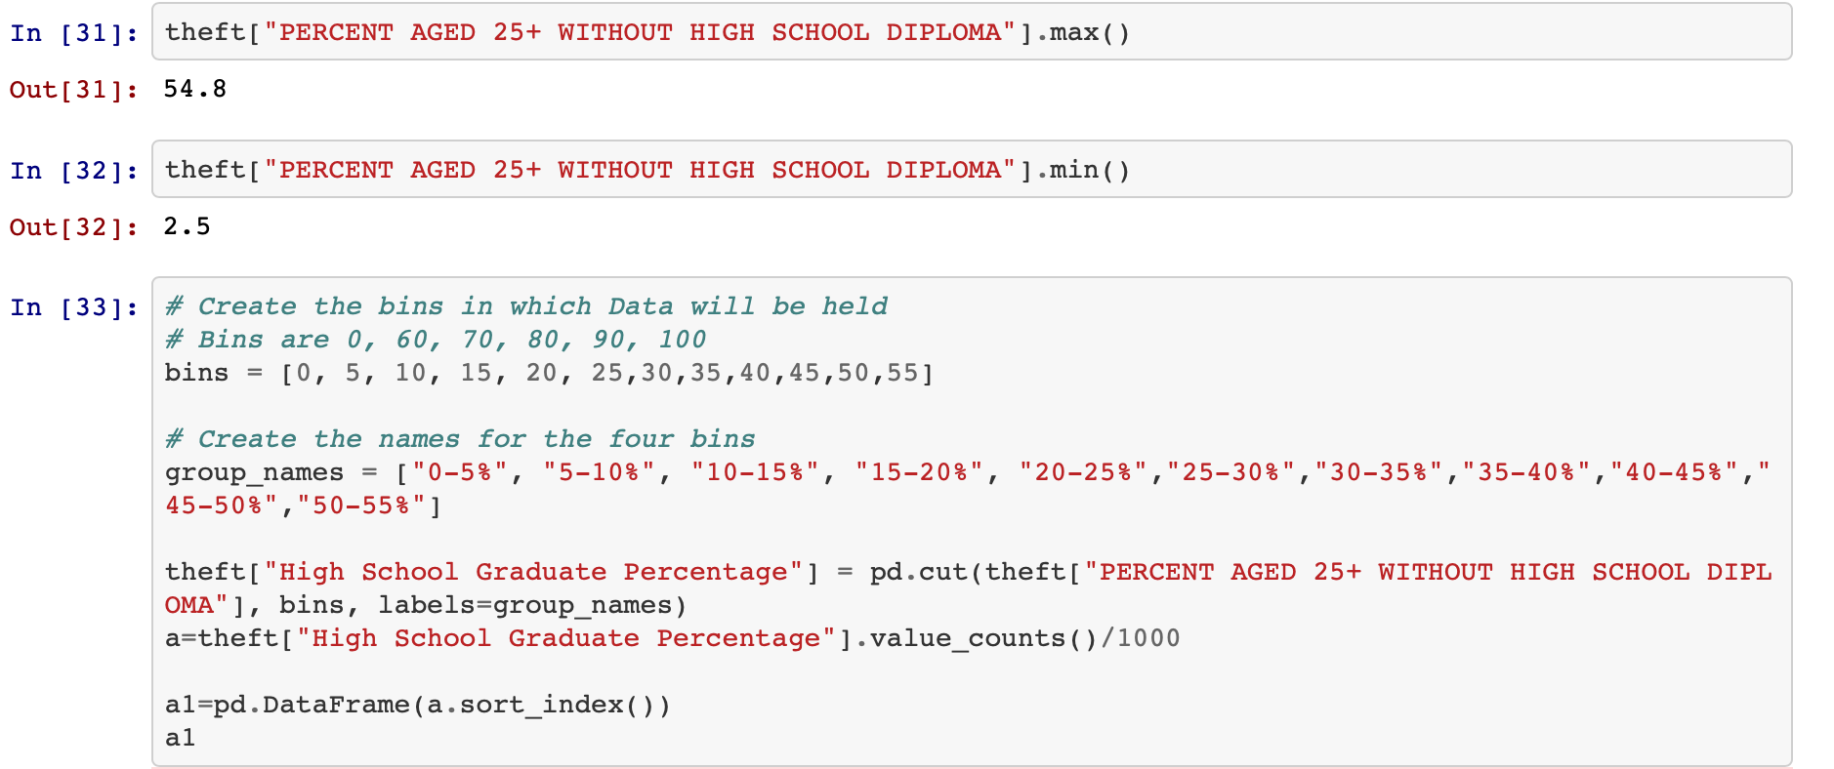
Relationship between Theft and High School Diploma

Slide 13
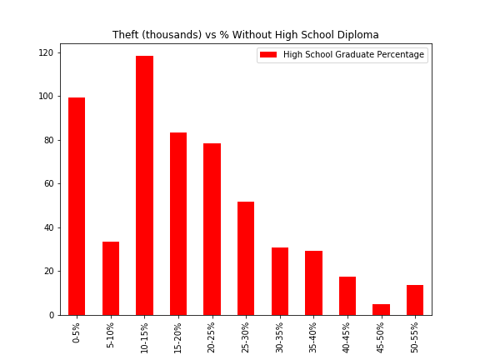
Theft vs % Without High School Graduate Percentage
% without High School | Theft
0-5% | 99.358
5-10% | 33.626
10-15% | 118.199
15-20% | 83.236
20-25% | 78.196
25-30% | 51.724
30-35% | 30.704
35-40% | 29.352
40-45% | 17.390
45-50% | 5.033
50-55% | 13.641

Slide 14
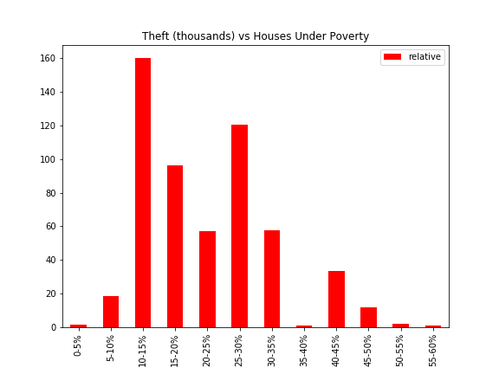
Theft vs % Houses Under Poverty

Slide 15
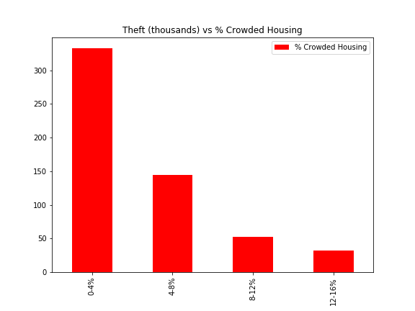
Theft vs % Crowded Housing

Slide 16
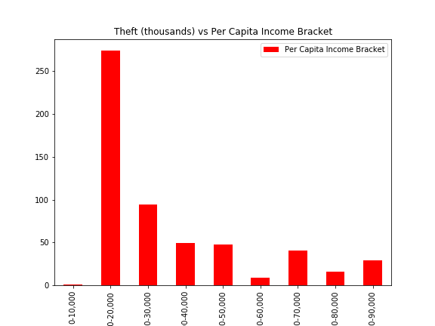
Theft vs Per Capita Income Bracket

Slide 17
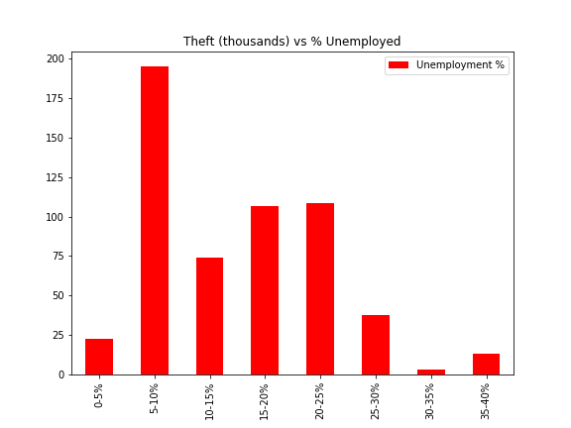
Theft vs % Unemployed

Slide 18
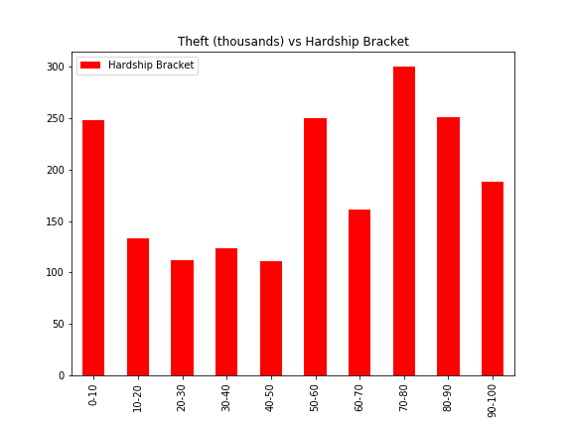
Theft vs Hardship Bracket

Slide 19
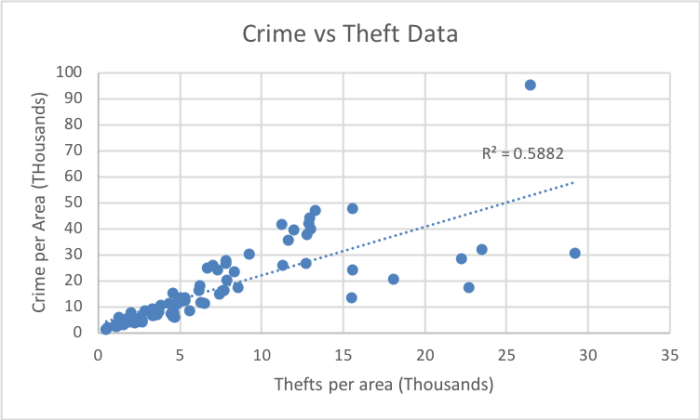
Crime vs Theft Data

Slide 20
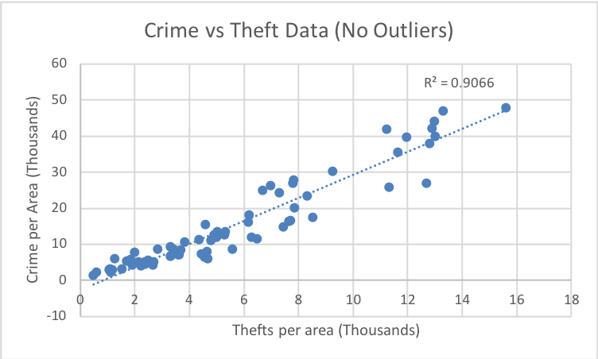
Crime vs Theft Data (No Outliers)

Slide 21
Conclusion
The Areas with poverty do not have high Theft
The Areas within Average income and unemployment levels have the highest Theft.
In areas with less than 16,000 thefts, the crime levels can be predicted.

Slide 22
Thank You !
Question Time

